Slide 1
Lecture 3 Describing and Visualizing Distributions

Slide 2
Review
Statisticians use to data to answer questions about populations
A population is the set of ALL observations of interest
Our data is usually a subset of observations from the population called a sample
The way in which we collect our data is called the sampling design

Slide 3
Review
A natural first step of statistical description is to look at graphical summaries of the observations for our variables
A distribution of a variable gives (a) the values that occur and (b) how often each value occurs
A frequency table is a tabular descriptions of the distribution of a variable – it can be applied to either quantitative or qualitative variables

Slide 4
Graphical Descriptions Of Data
Frequency Tables
Qualitative Variables
Quantitative Variables
Bar graph
Pie Chart
Pareto Chart
Dot Plot
Stem Chart
Histogram
Describe key features of the distribution
Modal Category
Shape
Center
Spread

Slide 5
Frequency Tables for Continuous Variables
The number of possible values is usually very large
Convert continuous values into discrete groups (sometimes called bins):
Steps:
Divide the range of the variable into a set of non-overlapping intervals
Count the number of values that fall into each interval

Slide 6
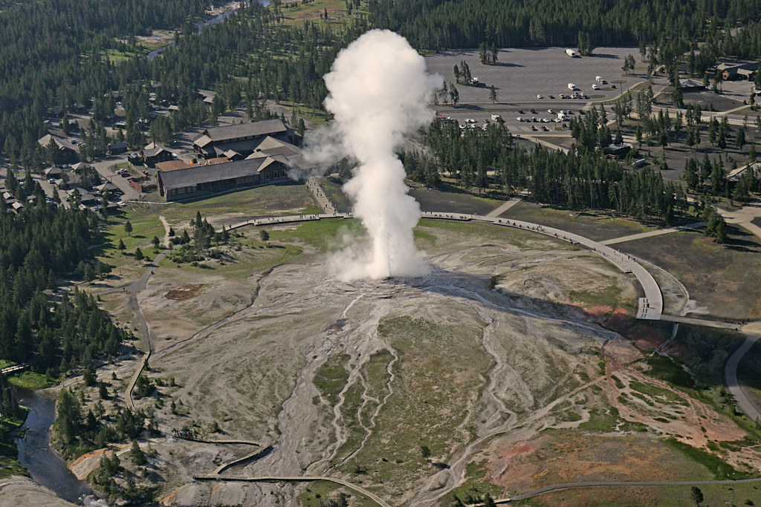
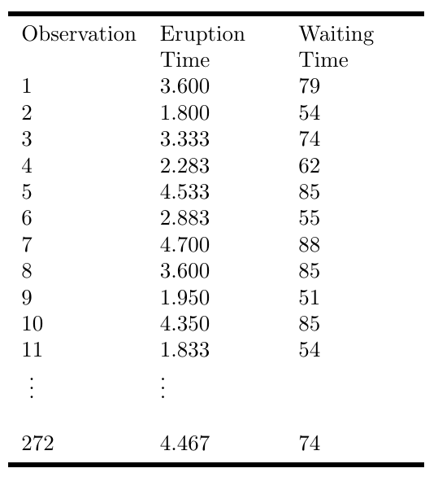
Example: Old Faithful Eruption Times

Slide 7
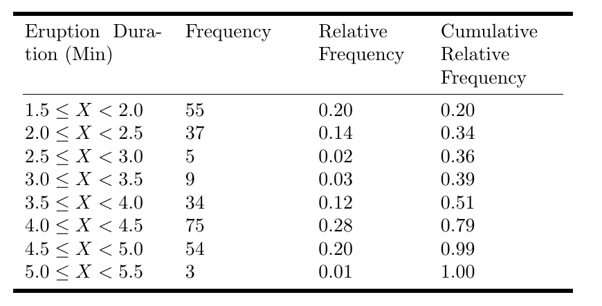
Old Faithful Eruption Times: Frequency Table

Slide 8
Visualizing Distributions of Categorical Data
Pie Charts - a circle divided into ‘slices’ corresponding to each category. The size of a slice shows the proportion of observations in a category
Bar graph – displays a vertical bar for each category. The height of the bar shows the percentages of observations in the category
Pareto Chart - a bar chart with the categories ordered by decreasing frequency

Slide 9
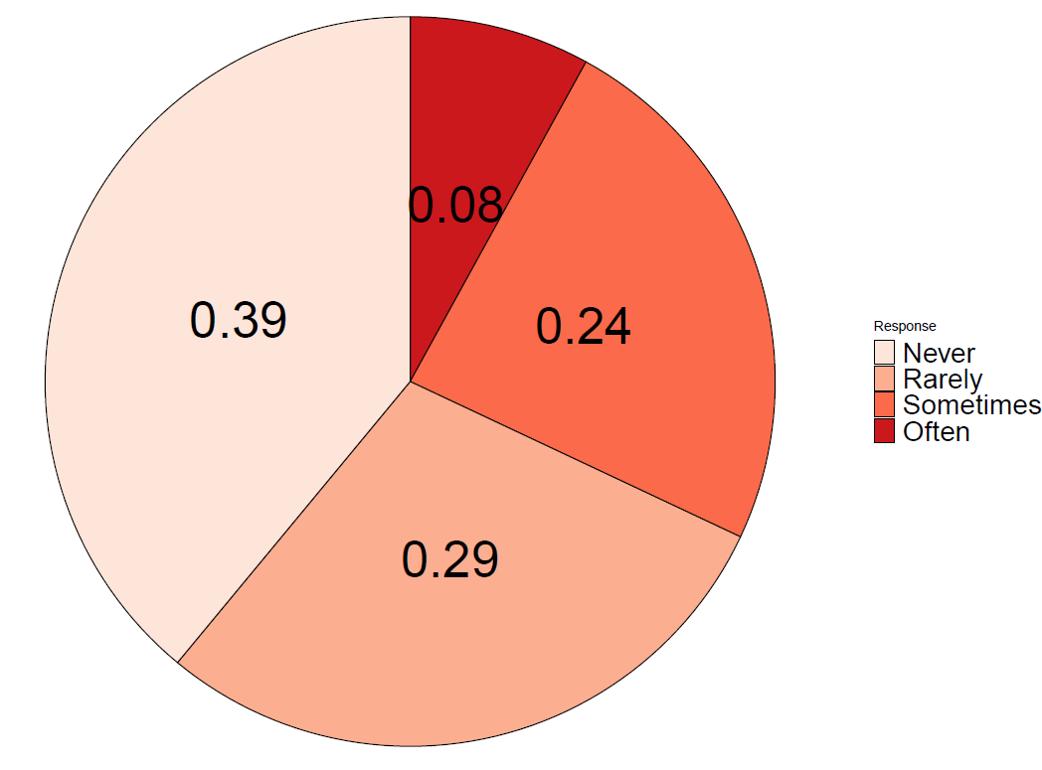
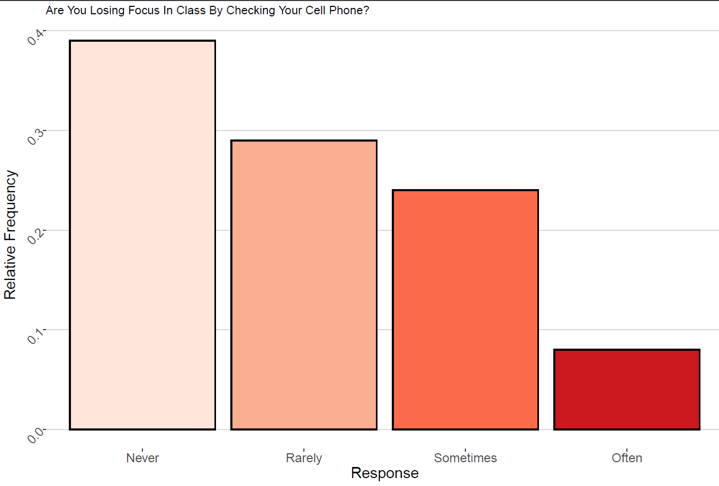

Slide 10
Visualizing Distributions: Quantitative Variables
Dot plots – shows a dot for each observation placed above the value for that observation
Steps to construct a dot plot
Draw a horizontal line and mark the line with regular values of the variable
For each observation, place a dot above its value on the number line
Works best with quantitative discrete data
Doesn’t work well if the variable is continuous and takes on many distinct values…
For continuous data, the values may need to be round to the nearest tenth or integer

Slide 11
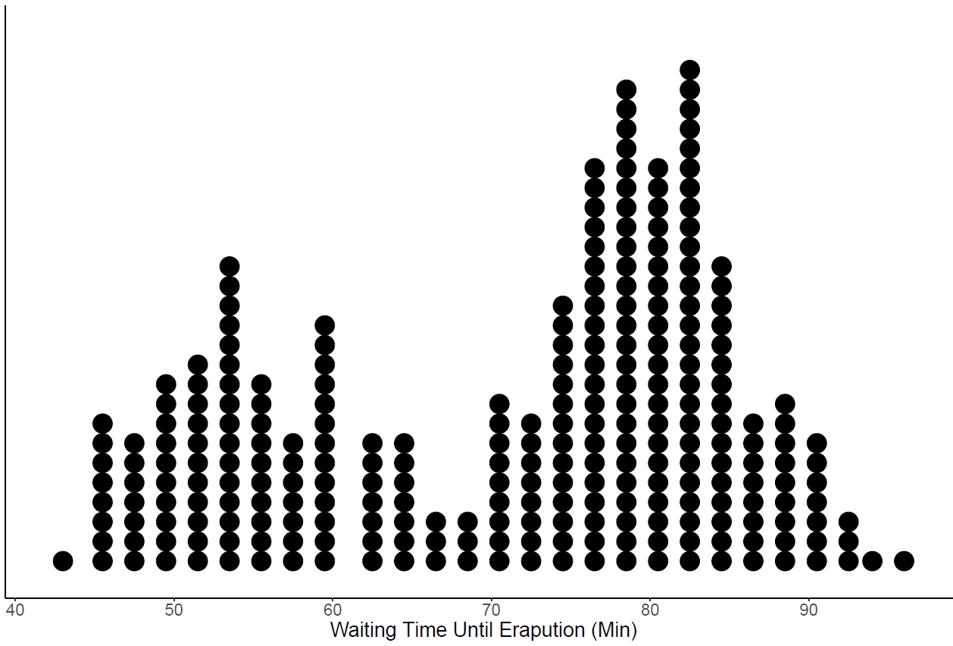

Slide 12
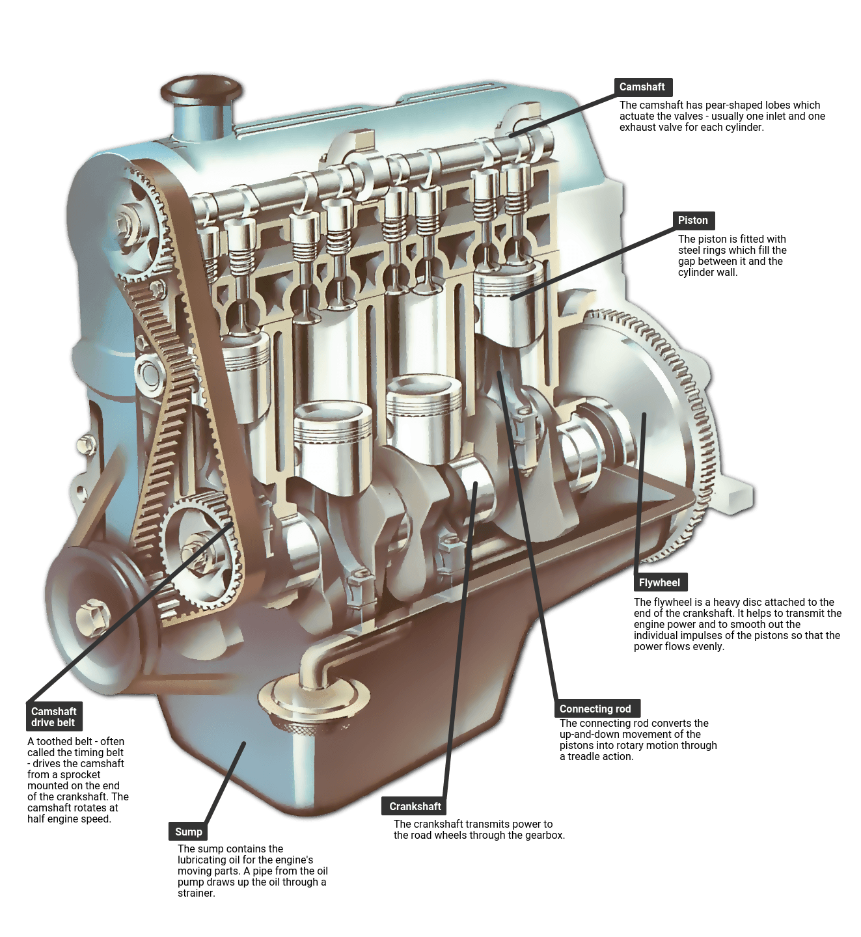
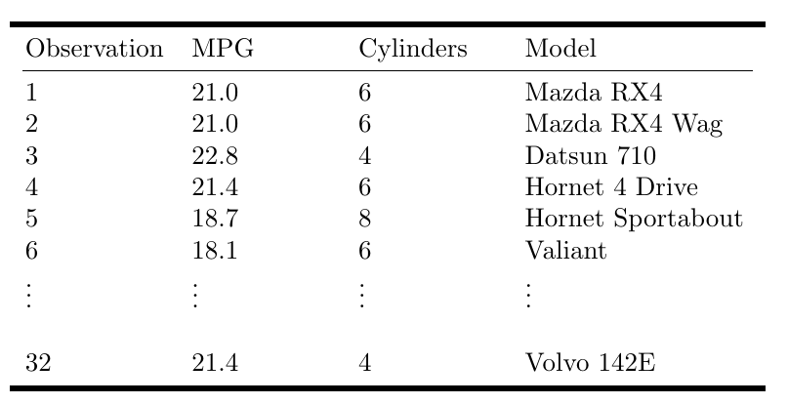
Example: MPG and Engine Cylinders

Slide 13
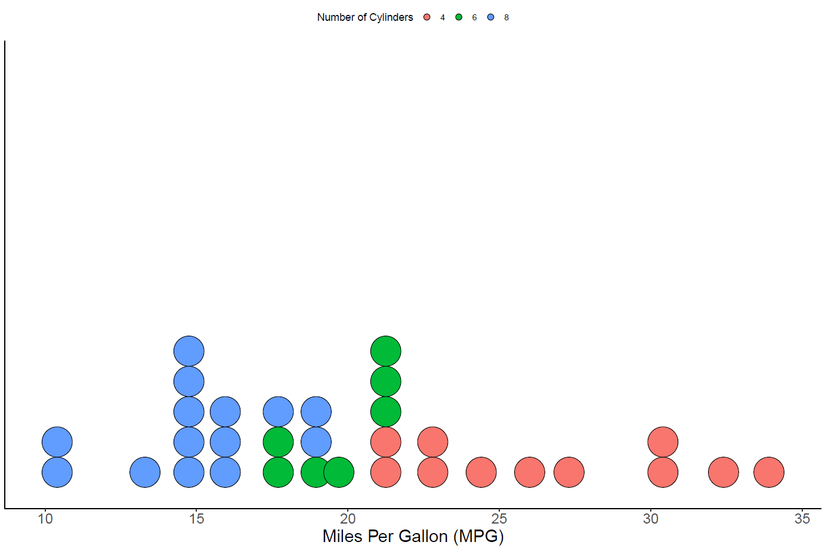

Slide 14
Visualizing Distributions: Quantitative Variables
Stem and leaf plot – like a dot plot, a stem and leaf diagram also displays individual observations.
Stem – all the digits in an observation except the last digit
Leaf – the last digit in an observation
Steps to construct a stem and leaf plot
Sort the data in order from smallest to largest.
Place the stems in a column in increasing order
Place a vertical line to the right of the stems
To the right of the vertical line, fill in the leaves that correspond with each stem in increasing order
82
Stems
Leaves
8 2

Slide 15
Example: MPG

Slide 16
Try it out: Stem and leaf plot
Data = 4.2, 3.8, 4.6, 3.2, 2.7, 8.2, 9.1, 0.2, 1.2, 6.2

Slide 17
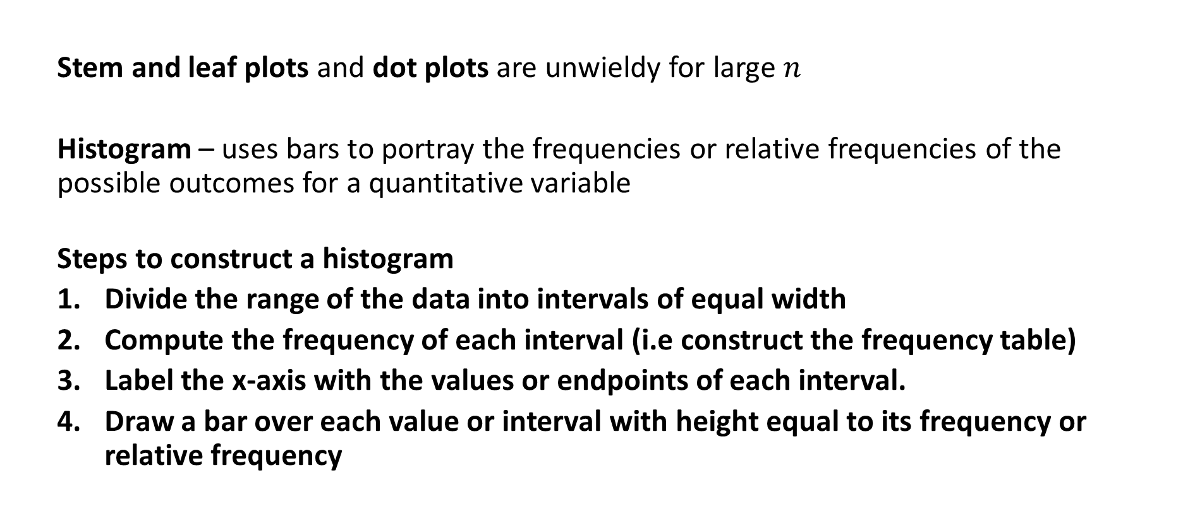
Visualizing Distributions: Quantitative Variables
Stem and leaf plots and dot plots are unwieldy for large $n$
Histogram – uses bars to portray the frequencies or relative frequencies of the possible outcomes for a quantitative variable
Steps to construct a histogram
Divide the range of the data into intervals of equal width
Compute the frequency of each interval (i.e construct the frequency table)
Label the x-axis with the values or endpoints of each interval.
Draw a bar over each value or interval with height equal to its frequency or relative frequency

Slide 18
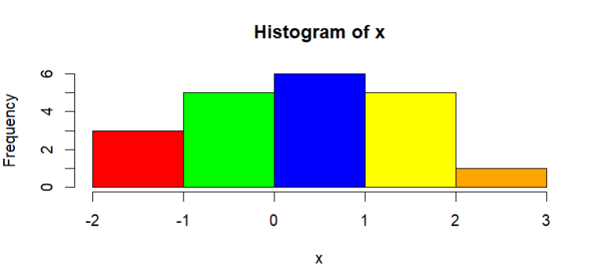
Try it out: Histogram
Consider the following $n=20$ observations of a continuous variable
Bin 1
Bin 2
Bin 3
Bin 4
Bin 5
x = -1.5, -1.2, -1.0, -0.8, -0.7, -0.6, -0.1, -0.1, 0.1, 0.1, 0.1, 0.6, 0.6, 0.8, 1.1, 1.2, 1.3, 1.8, 1.9, 2.4

Slide 19
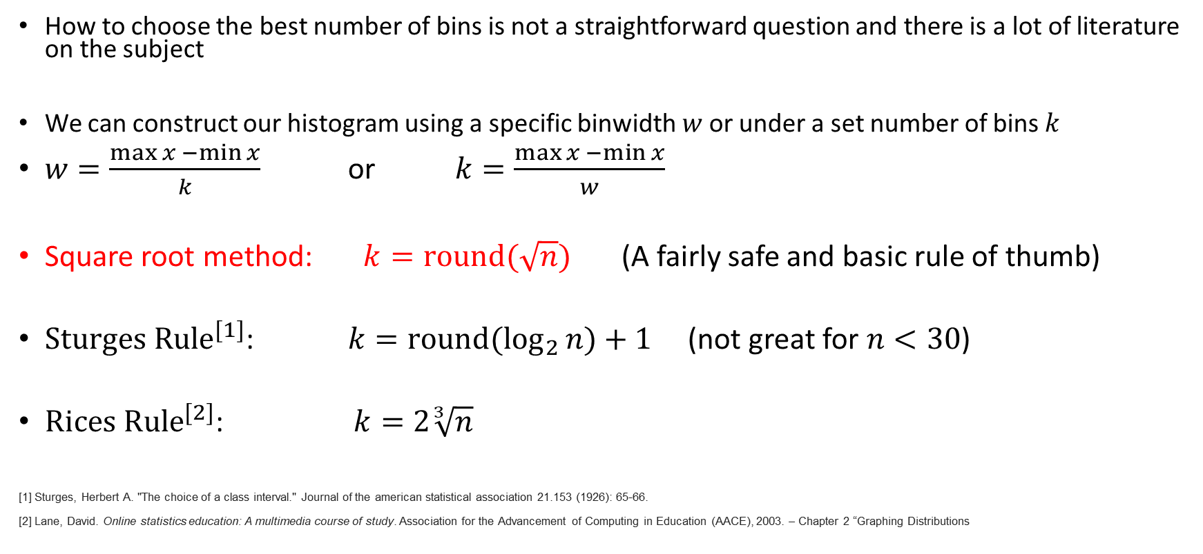
How to choose the number of Bins?
How to choose the best number of bins is not a straightforward question and there is a lot of literature on the subject
We can construct our histogram using a specific binwidth $w$ or under a set number of bins $k$
$w=\frac{\max{x −\min{x}}}{k}$ or $k=\frac{\max{x −\min{x}}}{w}$
Square root method: $k=round(\sqrt{n})$ (A fairly safe and basic rule of thumb)
${Sturges Rule}^{[1]}$: $k={round(log}_{2}{n)+1 }$ (not great for $n<30$)
${Rices Rule}^{[2]}$: $k=2\sqrt[3]{n}$
[1] Sturges, Herbert A. "The choice of a class interval." Journal of the american statistical association 21.153 (1926): 65-66.
[2] Lane, David. Online statistics education: A multimedia course of study. Association for the Advancement of Computing in Education (AACE), 2003. – Chapter 2 “Graphing Distributions

Slide 20
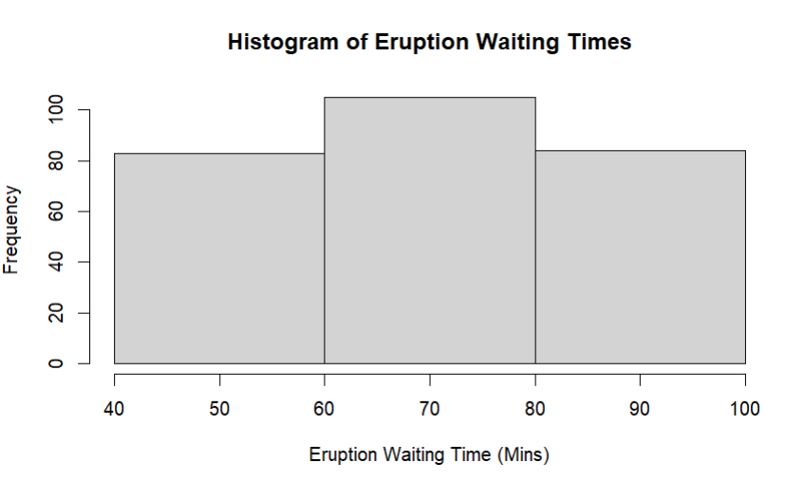
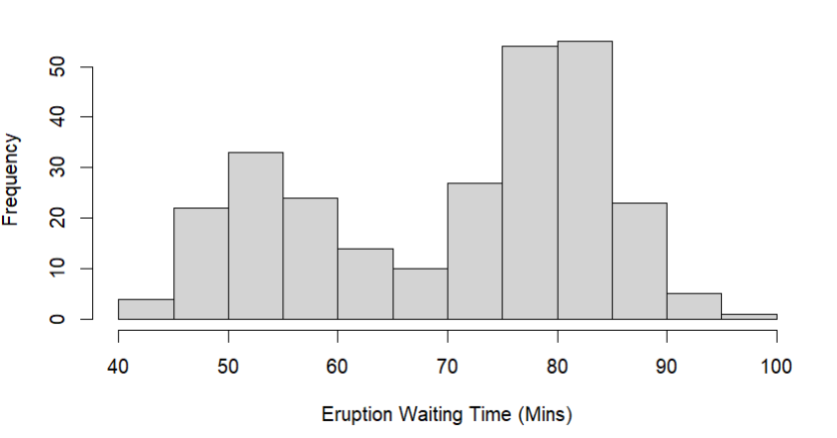
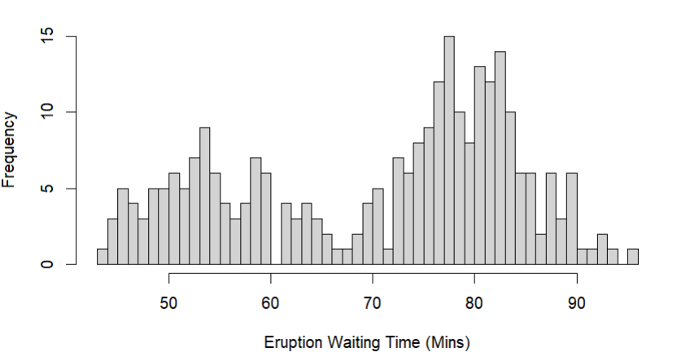
Some tips
If too few intervals are used, then the graph will be too crude
If too many intervals are used, graph will contain many short bars and gaps.
Usually between 5 - 15 intervals are enough.
Most plotting software will automatically choose the number of bins.
ALWAYS plot the histogram to get an idea about the shape of the distribution of a quantitative variable
Is the number of observations is small (say n < 50) then it’s a good idea to supplement a histogram with a dot plot or stem plot

Slide 21
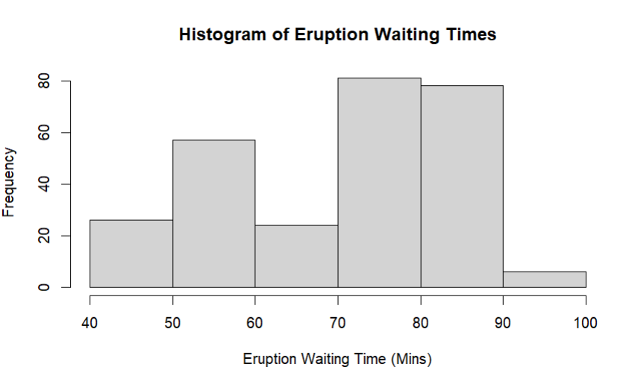
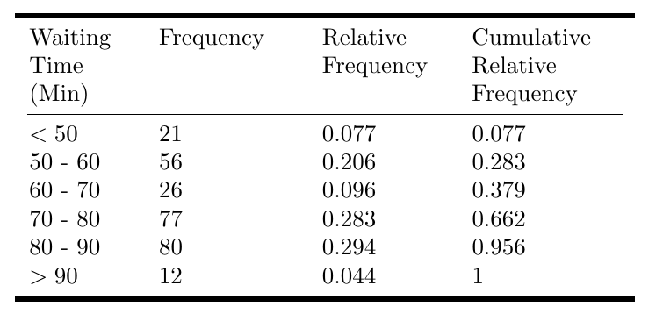
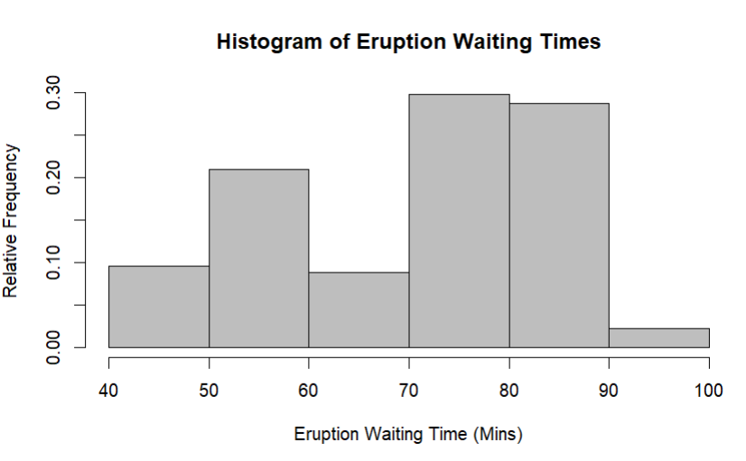
Example: Old Faithful Eruption Times

